Slide 1

Advertising mapping : using OpenStreepMap for the protection of landscape
Paul Desgranges at SOTM Milano 2018

Slide 2
Outline
Which advertising devices ?
Why bother to do this ? Is it useful ? Is it necessary ?
How to map ?
Tools : preset JOSM, OSM Contributor, MapContrib.
Status
Rendering : icones, openadvertmap, umap
Stats per type and per country

Slide 3
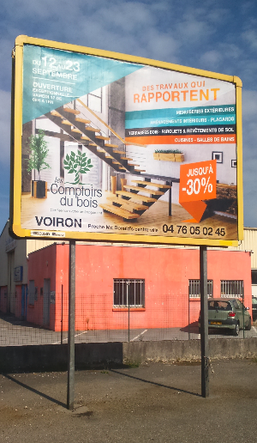
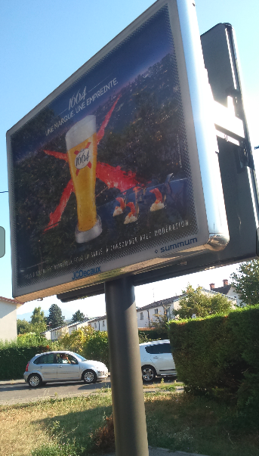
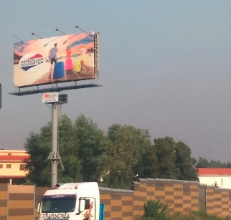
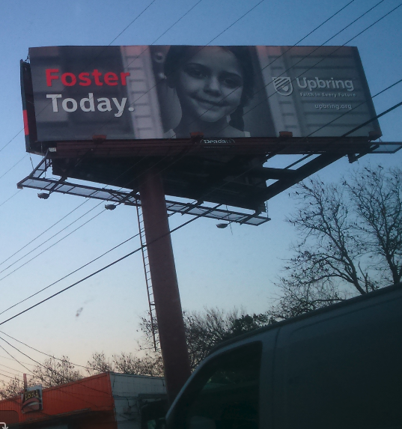
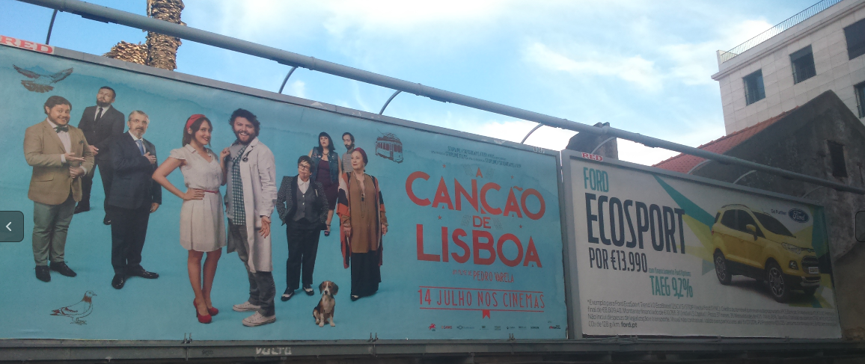

Slide 4
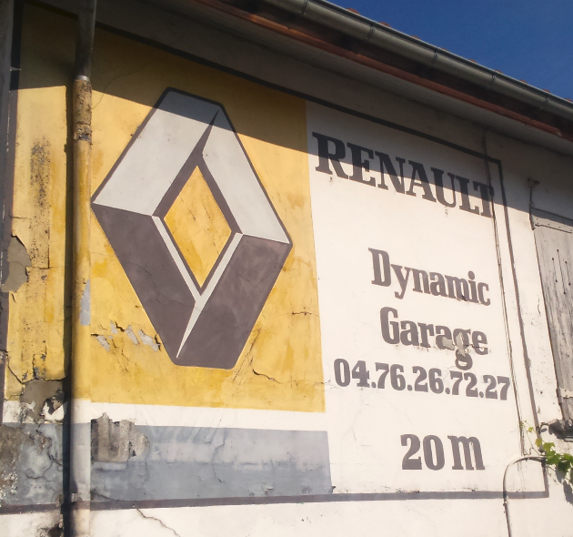
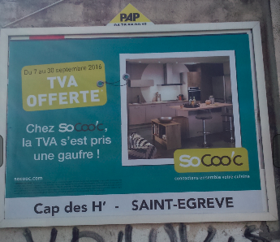
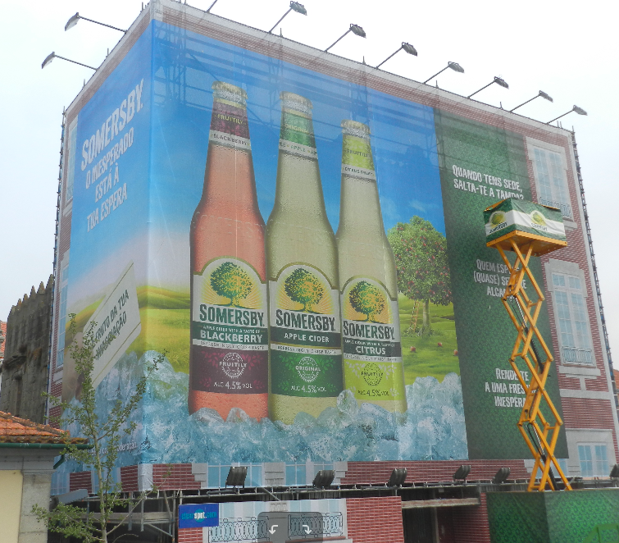
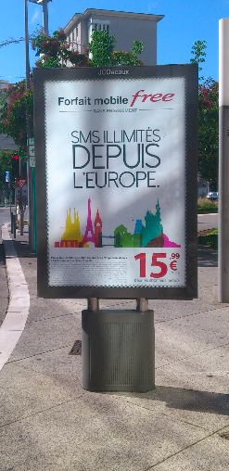
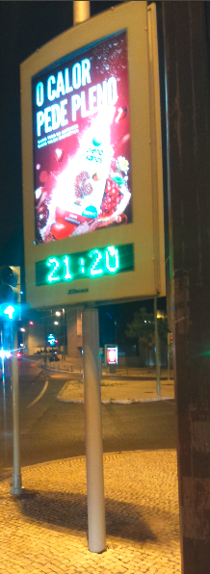
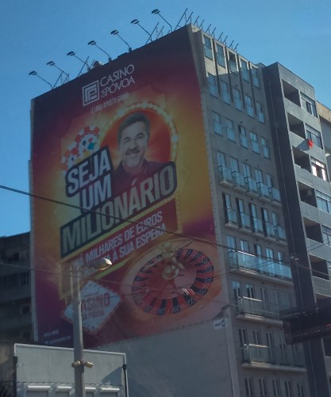
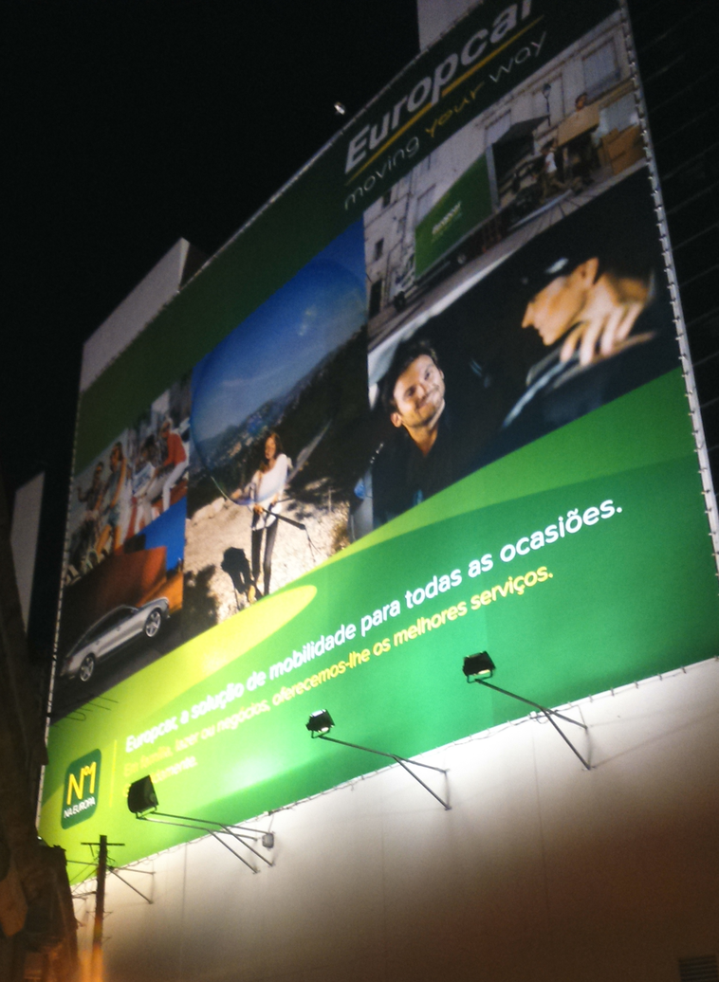

Slide 5
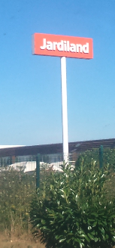
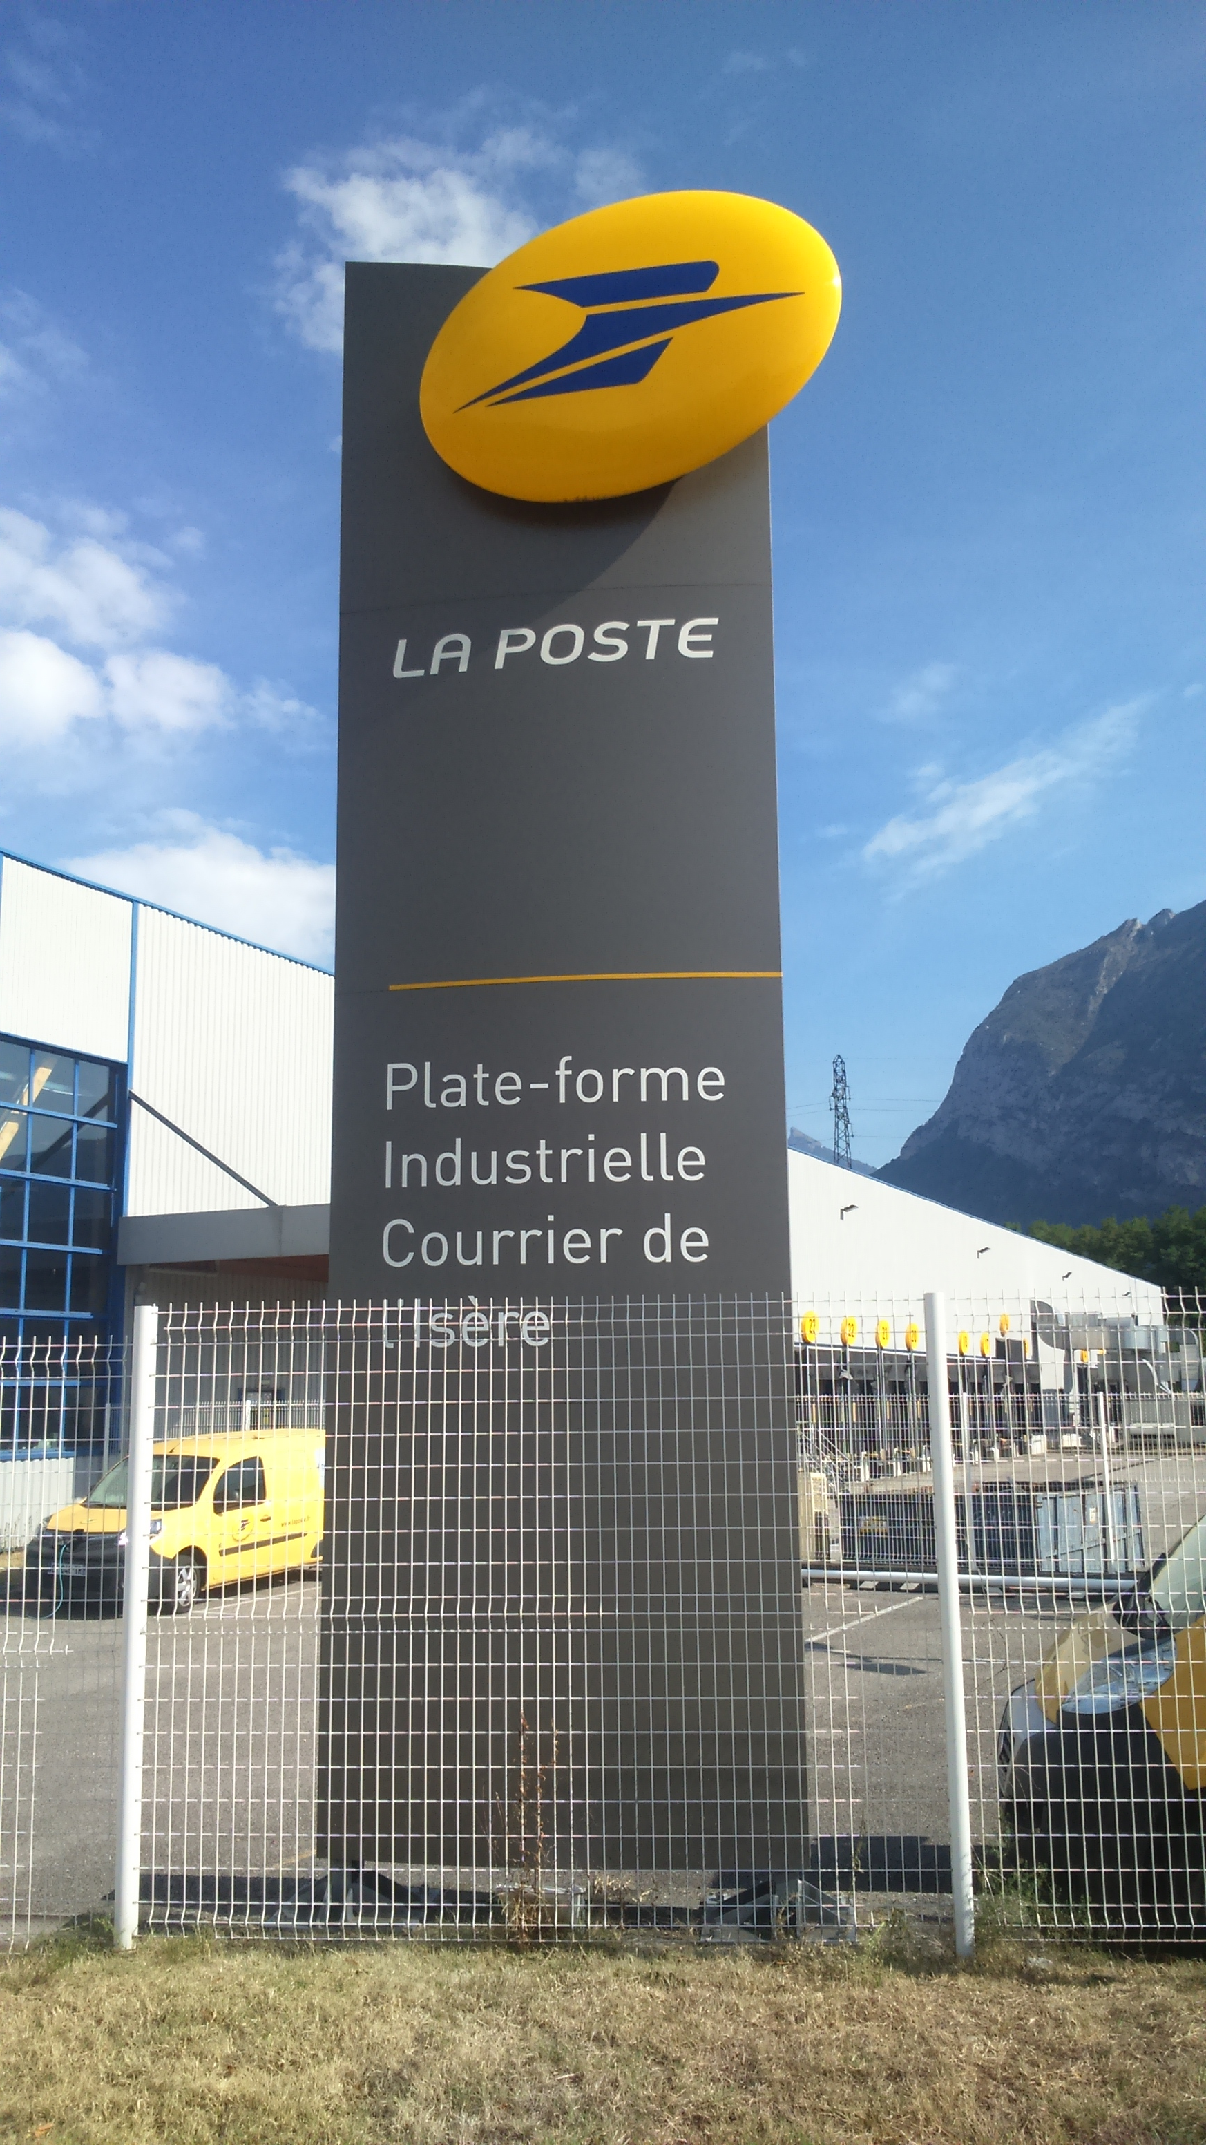
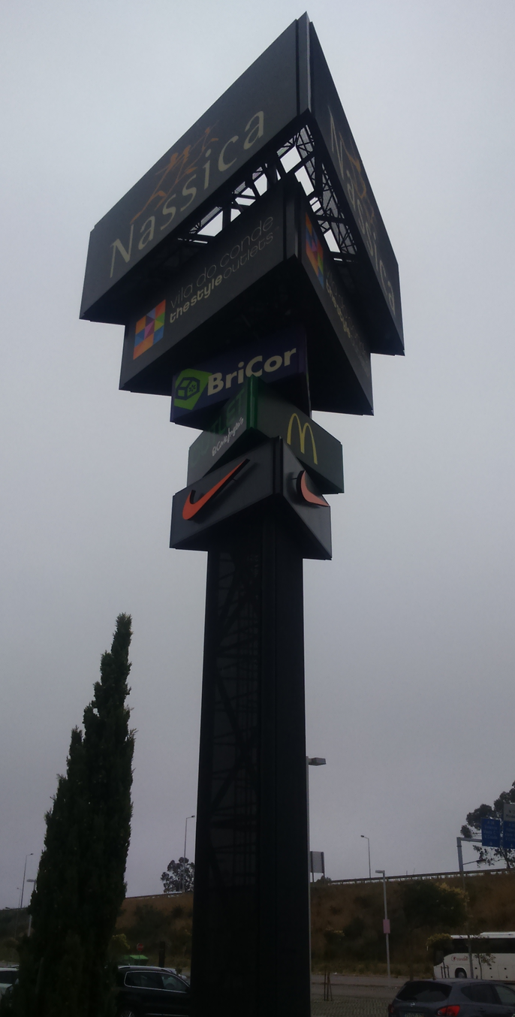
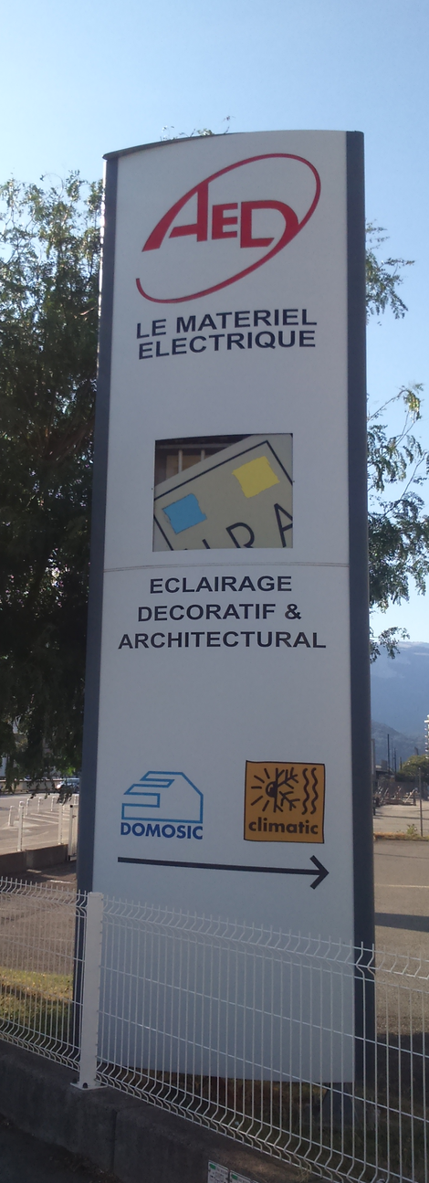
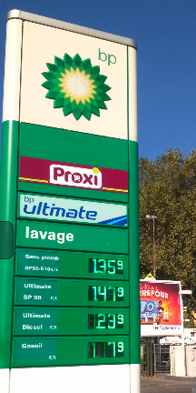

Slide 6
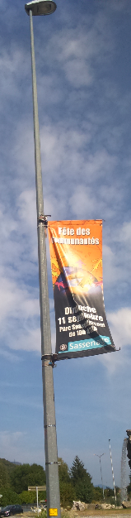
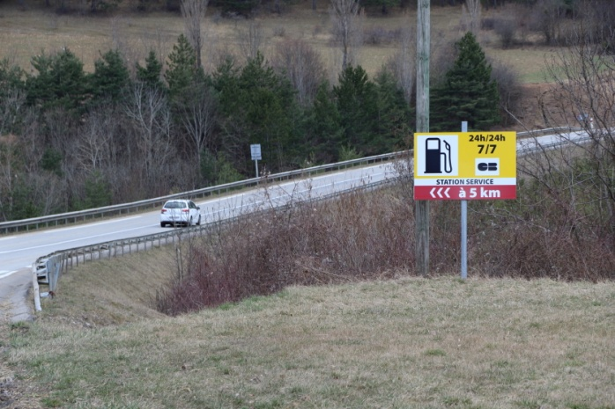
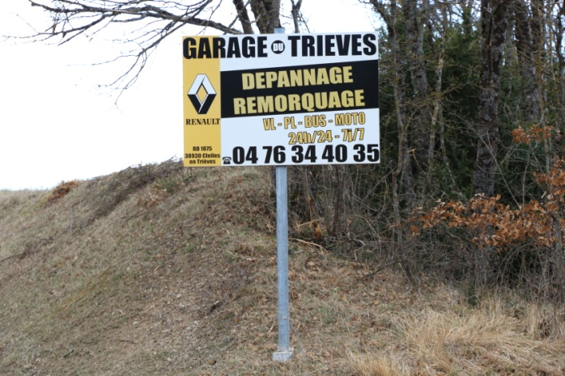
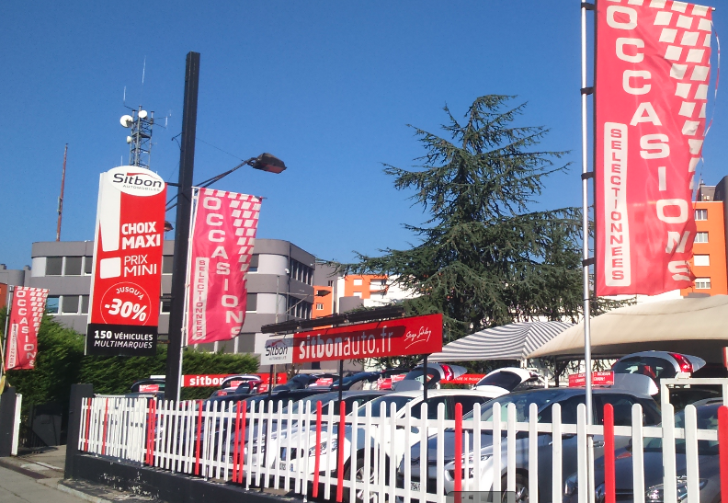
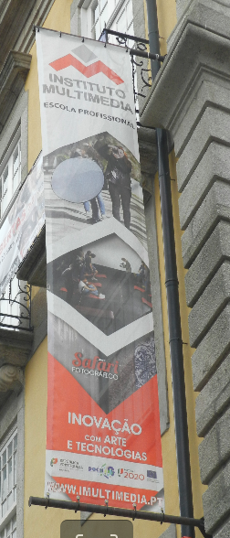
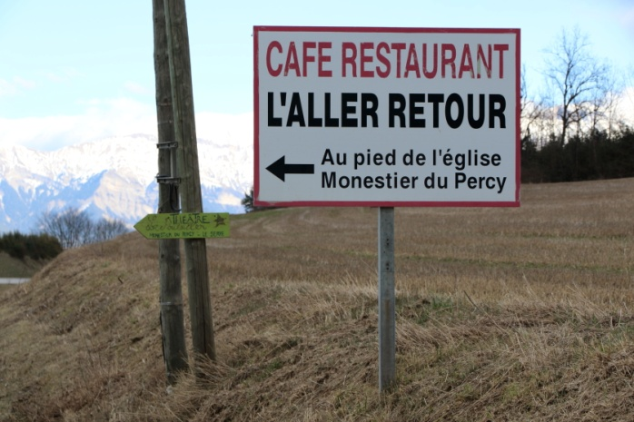
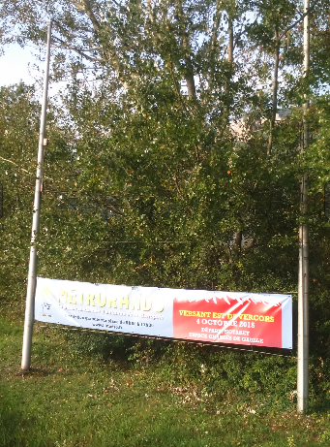
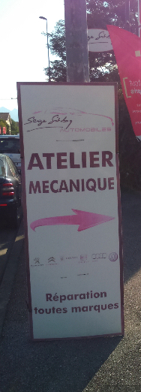
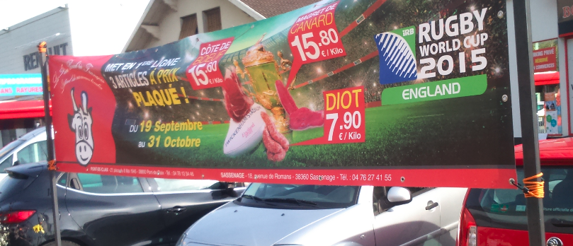

Slide 7
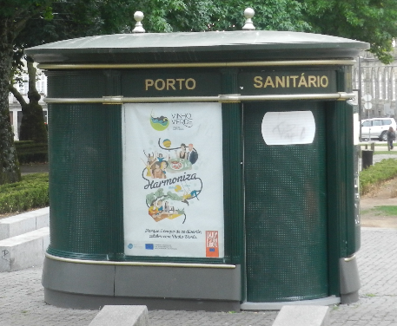
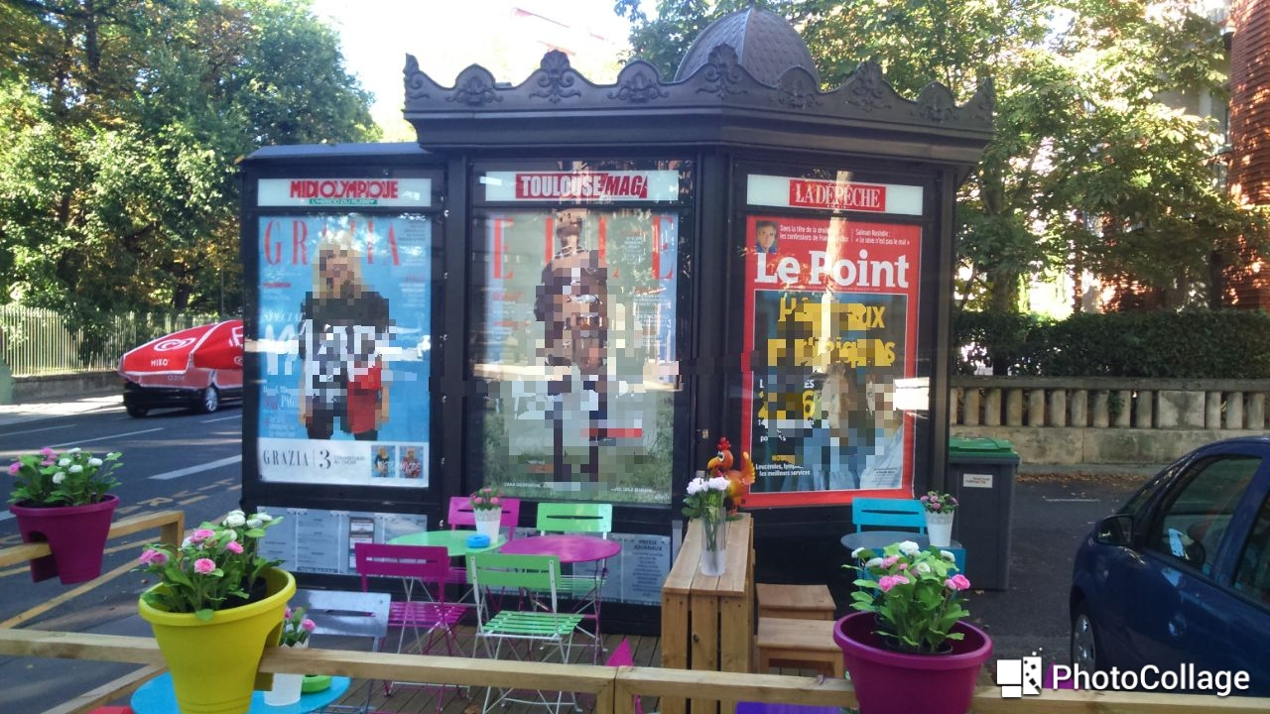
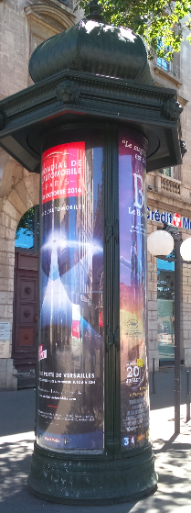
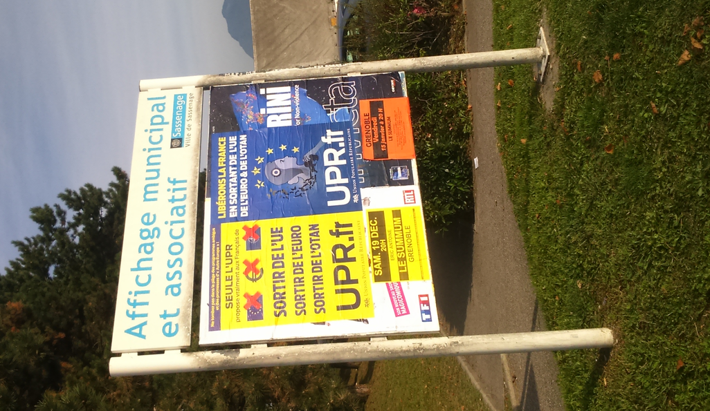
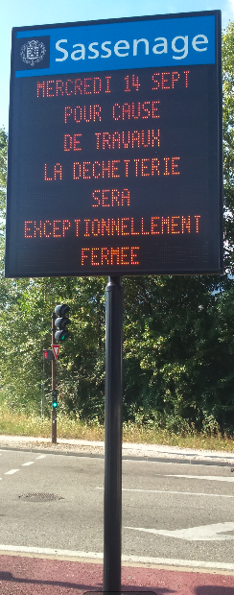
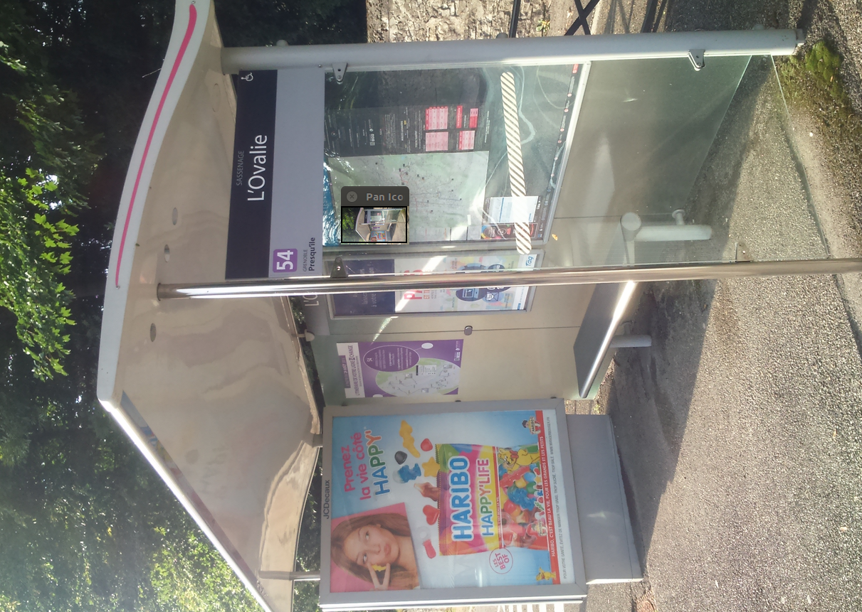
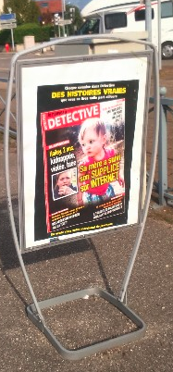

Slide 8
Legislation on advertising in public space in France is the result of 100 years of discussion on :
Heritage,
remarkable
natural sites,
landscapes
Freedom of expression
Economy, handicraft, trade, industry
12/07/2010 : law ENE (Engagement National pour l’Environnement)
30/01/2012 : decree RNP (Réglement National de Publicité)
Complexity !
Quality of the living
environment
Environment,
ecology,
preservation of
resources

Slide 9
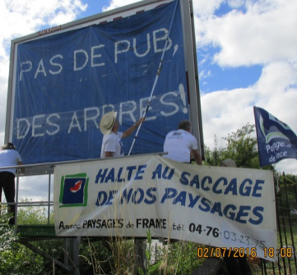
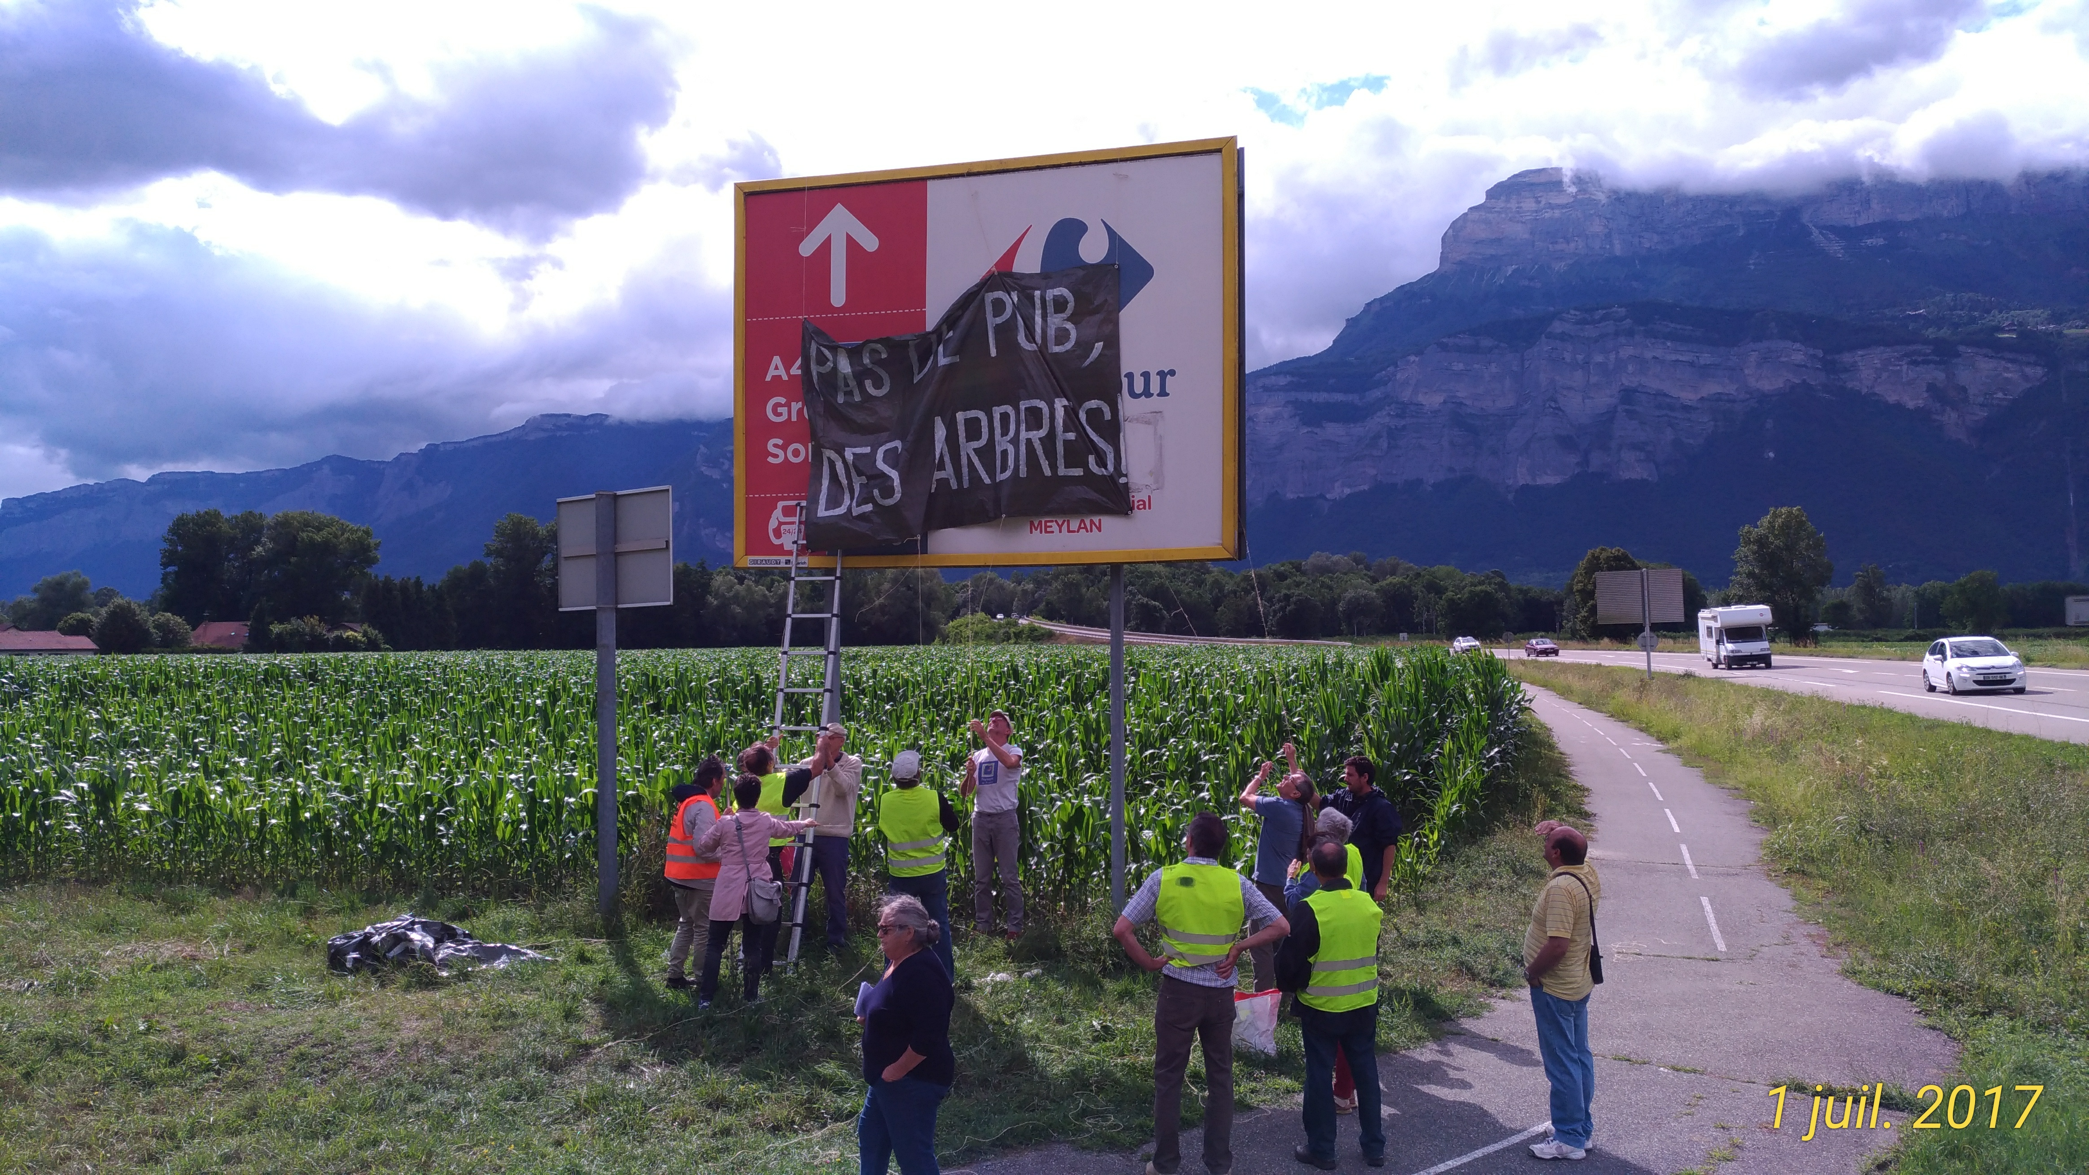
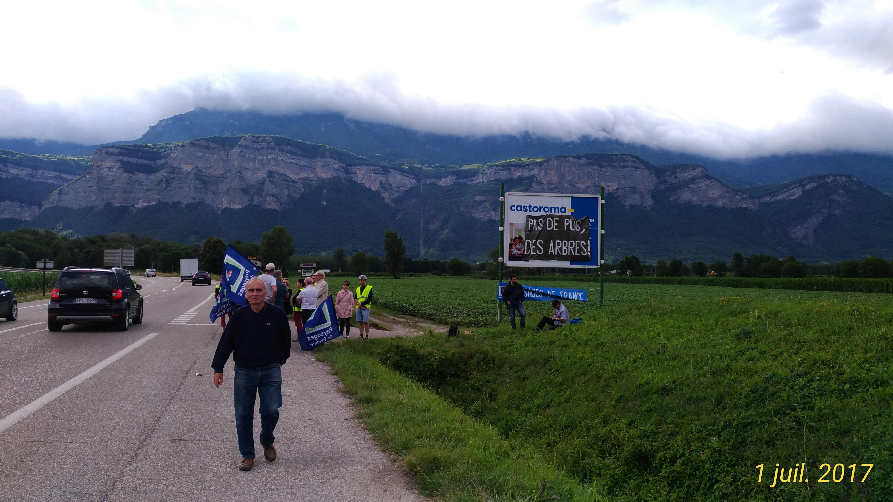
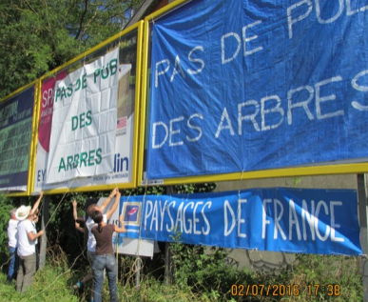
« No ad ! Trees instead !! »

Slide 10
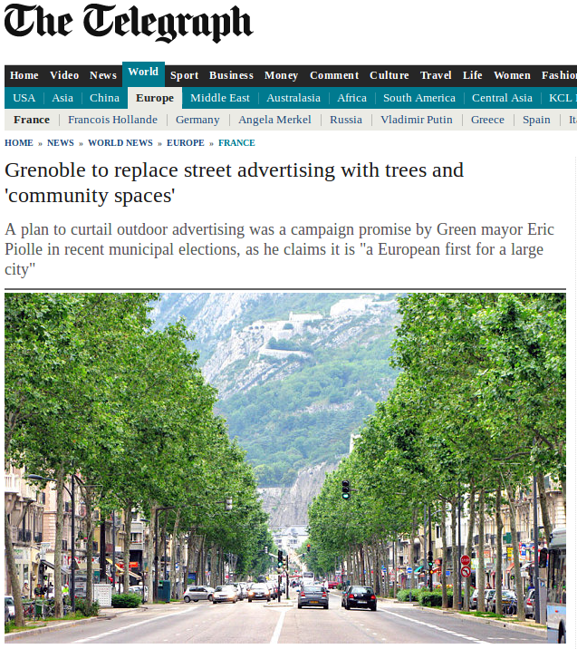
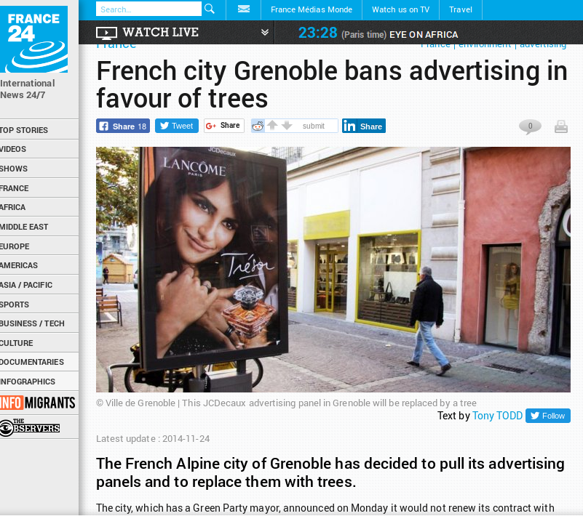
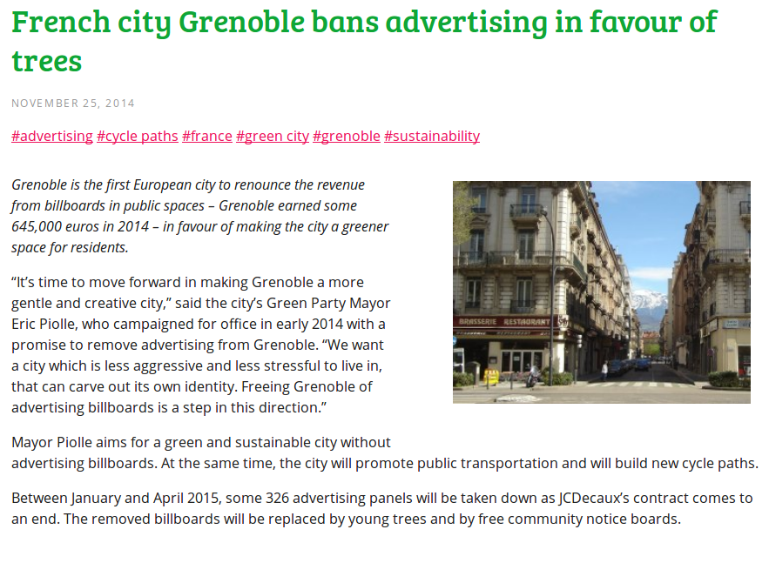
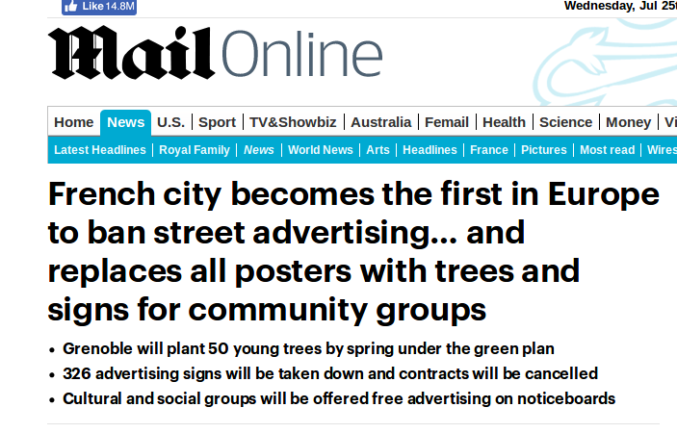
Grenoble didn’t renew adv. contract in 2014, 326 adv devices banned from public space

Slide 11
Advertising devices into OSM : what for ?
Aims 1
Store into OSM DB what can be seen on landscape
Perform inventory (how many, density)
Compare towns with same characteristics
Follow changes in time
Aims 2
Be able to verify legality of installation, automatic detection of infractions ?
Aims 3
Be able to measure advertising pressure
On a city, along an itinerary, …

Slide 12
How to tag into OSM ?
man_made=advertising (first level tag, not mandatory)
Tag advertising : external aspect (form factor)
Then visibility, number of sides, lit, luminous, animated, support, overall size, height.
Then legal aspect : operator, private/public property, type of message, display size, legal type according to local legislation
Visibility (nuisance or impact)

Slide 13
External aspect of device
advertising=<value> is first level tag (if man_made=advertising is not). To give the external aspect of the device
advertising=billboard
advertising=poster_box
advertising=totem
advertising=column
advertising=board
advertising=tarp
advertising=sign
advertising=flag
advertising=sculpture

Slide 14
Visibility : device visibility
visibility
visibility=house : device for pedestrians, visible up to 10 m
visibility=street : device for vehicles driving slowly, visible between 10 and 50 m
visibility=area : device visible from far, or for vehicles driving fast, visible from more than 50 m

Slide 15
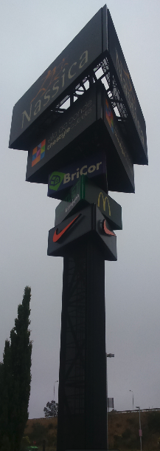
Number of sides
sides : the number of sides of the devices
sides=1 wall devices, tarps, most of the boards in town, default value
sides=2 totems, most of grounded devices
sides=3 rarely
sides=4 rarely

Slide 16
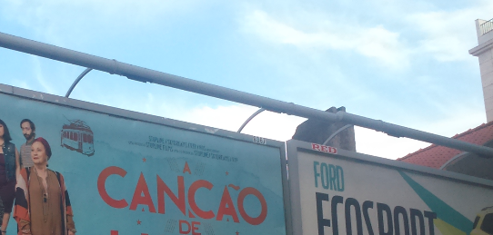
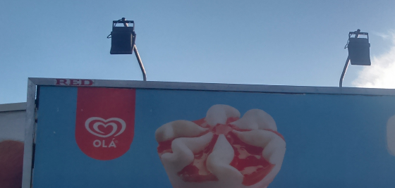
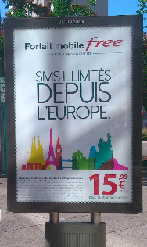
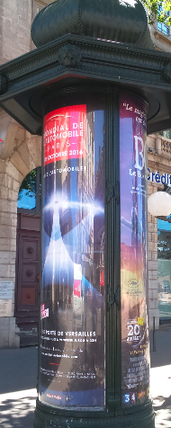
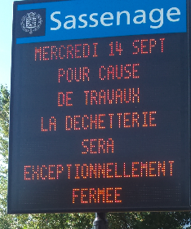
lighting
lit : yes/no
Proposal
lit=projection spots or neon ramps
lit=transmission poster_box lit from inside
lit=neon
lit=numeric all types of digital display
lit=screen all types of screen

Slide 17
Animation type
animated :
animated=yes/no
animated=trivision_blades : small triangles rotating
animated=winding_posters : several posters, often 3, winding one after the other
animated=rotating : advertising columns rotating on itself
animated=screen : a screen is an animation type
animated=digital_prices : for petrol stations for example
animated=digital_messages : for electronic display
animated=wind : some easels on ground are rotating with wind

Slide 18
Support
support to qualify what supports the device
support=wall
support=poles/pole/ground devices grounded (either poles, or a large unique pole ‘trunk’ [“advertising tree”]) or directly put on the ground, in Franc poles for telecom/electricy/light/traffic sign are not allowed to support advertising
support=mast device supported by a mast
support=fence In France blind fence only can support advertising
support=post In France many advertising boards are supported by a post
support=easel not mandatory if advertising=easel
support=scaffold mostly for advertising=tarp
support=ceiling ou roof supported on roof
support=street_furniture; street_furniture:transit_shelter ; street_furniture:newspaper_kiosk ;street_furniture:flower_kiosk ; street_furniture:information ; street_furniture:map ; street_furniture:bench ; street_furniture:trash ; street_furniture:recycling ; street_furniture:clock ; street_furniture:toilets all kinds of urban furnitures being able to support advertising. In France only 5 of them are allowed : transit_shelter, newspaper_kiosk, information, …

Slide 19
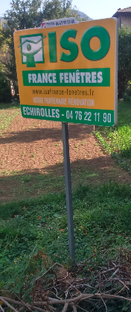
Overall size
size : external size of the device (without the support), it is not the display size, but the size of display size AND the frame
Difficult to measure precisly, but they are standard formats
width x height in meter
size=1.5x1
size=1.3x2.15 (1.2x1.7 => 2m²)
size=3.5x2.7 (3.2x2.5 => 8m²)
size=4.2x3.2 (4x3 => 12 m²)
size better than width + height, because there is as well display_surface, and height for the overall height of device

Slide 20
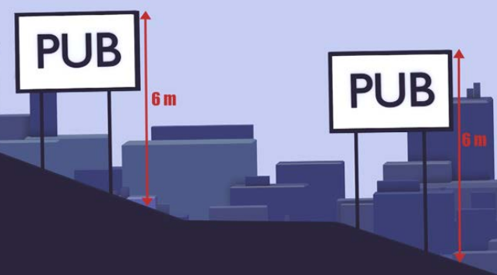
Height
height : the height of the highest point of device from the lowest point, average height has no meaning here, this is not the height of the display surface
In meter :
height=2.4 often for poster_box
height=6 often for grounded billboard (max height in France)
height=7.5 often for wall billboard (max heigth in France)

Slide 21
Operator
operator to qualify the one performing display, advertising company, or town, or shop, of brand , …
operator=JCDecaux
operator=Ville de Grenoble
operator=SMTC (Syndicat Mixte des Transports en Commun)

Slide 22
Reference
reference identifier of advertising device, supposed to be unique by an advertising company, supposed to be visible in France on all devices (“buteau”)
ref=

Slide 23
Land
land_property to tell if the advertising device is on private land or public land
land_property=public
land_property=private

Slide 24
Type of message
message : type of advertising message. Only if permament characteristics.
message=commercial vast majority, default value
message=opinions/non_profit In France we have mandatory boards for free speech and non profit organization in all towns in France, reserved space for freedom of expression.
message=information municipalities
message=showbiz In France adv columns in town can only displya advertising for showbiz (theater, music, movie, concerts, ...)
message=map for geographic information
message=political for electoral boards, with “permanent=no” as only during election campains in France
message=safety for safety warnings, flood,
message=legal for legal information
Etc. Other values are possible
When there are two sides it is possible to have message:front=commercial and message:reverse=information for example for urban furniture ad hoc

Slide 25
Legal device type in France
legal_type:FR to qualify the legal type of device in France
legal_type:FR=publicité
legal_type:FR=publicité:mobilier urbain:panneau
legal_type:FR=publicité:mobilier urbain:colonne
legal_type:FR=publicité:mobilier urbain:mât porte-affiches
legal_type:FR=publicité:mobilier urbain:abri transport
legal_type:FR=publicité:mobilier urbain:kiosque
legal_type:FR=enseigne
legal_type:FR=enseigne:temporaire
legal_type:FR=préenseigne
legal_type:FR=opinions/associations
legal_type:FR=JEI

Slide 26
Supposed status of device against law in France
legal_status:FR to qualify legal status of device, as far as french legislation is concerned.
legal_status:FR=ok : device seems to respect french legislations.
legal_status:FR=to verify:comments : supposition is made that device does not respect legislation, to be verify by an expert, comments.
legal_status:FR=ko:comments : device does not respect legislation, add comments to explain.

Slide 27
To know if this device is usable by anybody or it is private and reserved
access to tell if it is possible to stick one’s own posters, enable to differentiate commercial boards from boards offered to free opinions and non profit organisations
access=open or yes
access=private or no

Slide 28
Size of display
display_surface This is the not the overall size of the device, but the size offered to the display.
Difficul to measure precisely
surface in meter²
display_surface=1.5 : for 1,5 m² => “préenseignes” in France
display_surface=2 : for 2 m² => poster_box
display_surface=8 : for 8 m² => a lot of grounded billboards in France
display_surface=12 : for 12 m² => a lot of grounded billboards in France

Slide 29
Visibility : to measure impact of device of advertising pressure of the device
orientation tells how the device is set as compared with the flow of people or vehicles
orientation=front
orientation=medium
orientation=parallel
orientation=reverse
orientation=multi

Slide 30
Visibility: to measure impact of device of advertising pressure of the device
Proposal
side to tell on which side of the road is located the device as compared of the side when the people or vehicles pass
side=same
side=opposite
side=middle

Slide 31
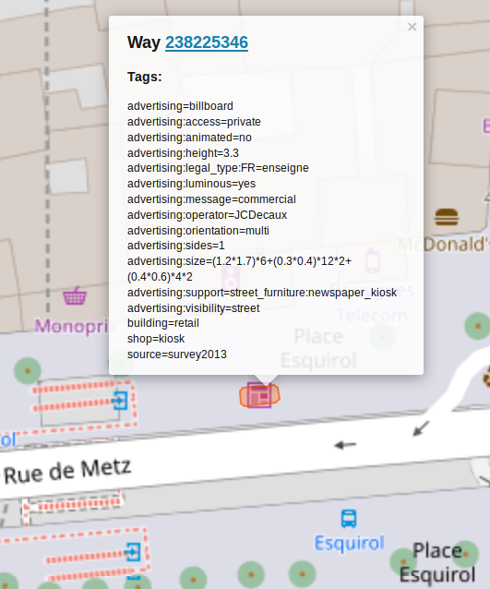
Scope “advertising:”
Advertising device can be installed on an existing object and to not mix advertising attributes and object attributes, “advertising:” scope can be added.

Slide 32
Tools
JOSM advertising presets : for main cases, to facilitate collection of information into JOSM
JOSM advertising style : to have a rendering into JOSM while we are editing advertising devices
OSM contributor : Androïd application with 3 profiles dedicated to 3 types of devices (being built)
Map Contrib : one theme to help advertising mapping contribution (being built)

Slide 33

JOSM advertising presets

Slide 34

JOSM advertising preset 1 out of 10

Slide 35











JOSM style

Slide 36



Androïd App : OSM contributor profiles (being built)
Political boards
Indication boards
Billboards

Slide 37

Map Contrib (being built) https://www.mapcontrib.xyz/t/cdd84c-Advertising_Devices

Slide 38

Stats per country : France

Slide 39

Stats per country : Italia

Slide 40

Stats per country : Germany

Slide 41
Stats on ‘advertising=*’ July 24th 2018

Slide 42
Stats on ‘advertising=billboard’ July 24th 2018

Slide 43
Stats on ‘advertising=column’ July 24th 2018

Slide 44
Stats on ‘advertising=poster_box’ July 24th 2018

Slide 45
Stats on ‘advertising=sign’ July 24th 2018

Slide 46
Stats on ‘advertising=totem’ July 24th 2018

Slide 47
Stats on ‘advertising=board’ July 24th 2018

Slide 48
OpenAdvertMap
http://projets.pavie.info/openadvertmap/#15/45.1803/5.7326

Slide 49
Some umap
Inventory of advertising devices in Boulazachttp://umap.openstreetmap.fr/en/map/panneaux-scelles-au-sol-boulazac_147909#15/45.1819/0.7760
Inventory of advertising devices in Grenoblehttp://umap.openstreetmap.fr/fr/map/dispositifs-publicitaires-grenoble_110558#14/45.1778/5.7200
Inventory of grounded signs of JDLD in Francehttps://umap.openstreetmap.fr/fr/map/inventaire-des-j_194621#6/46.619/6.218

Slide 50

Merci ! Thanks ! Grazie !
Presentation © Paul Desgranges 2018
<desgranges.paul@neuf.fr>
http://pdfext.github.io/OSM/SOTM_MILANO/index.html
Licence : Creative Commons By – SA 3.0
– (By) Attribution
– (SA) Share Alike
– http://creativecommons.org/licenses/by-sa/3.0/fr/

